Slide 1
Cybersecurity
Phishing

Slide 2
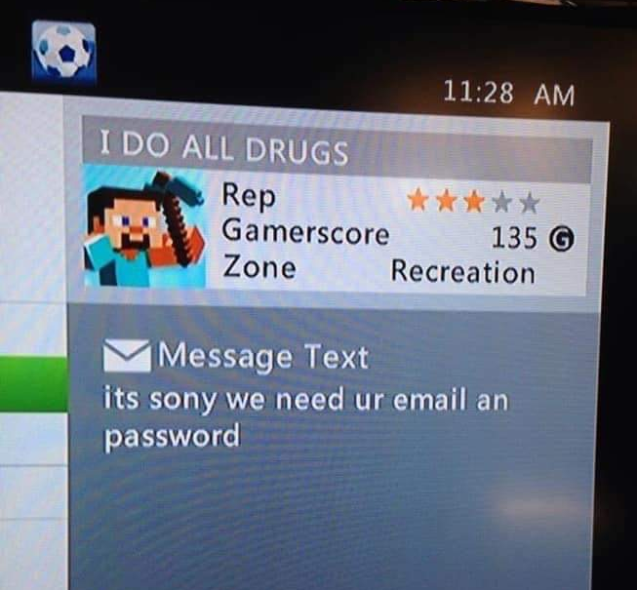
Phishing
Electronic social engineering
Often delivered by spam or via direct message
Can be convincing at times …or not
Don’t be fooled
Check the URL
Something is usually odd
Spelling, fonts, graphics, feeling

Slide 3
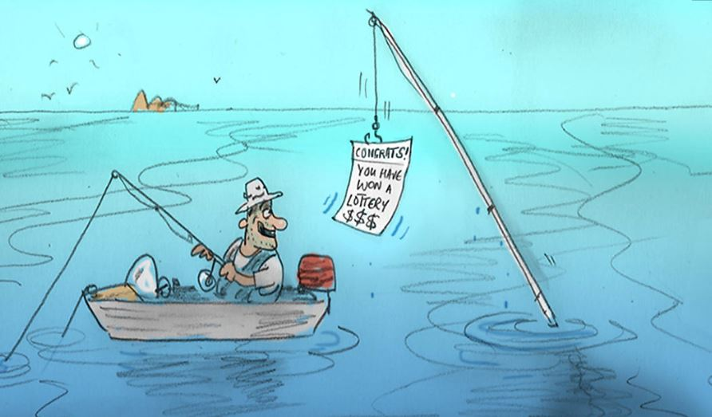

Slide 4
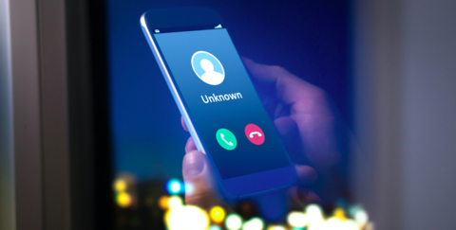
Vishing
Voice phishing
Sometimes digital voice, sometimes real human
“Hello! You’ve won a free cruise!”
“This is the Federal Revenue Service calling. There is a fine against your name.”
“This is the police. You have a warrant for your arrest if you do not pay immediately.” “Yes, you can pay with Apple or Starbucks gift cards.”

Slide 5
Spear Phishing
Phishing a specific target directly
Focused attack versus wide “net”
Uses inside information “Carlos in Accounting said…” “Janet in IT told me…” “That new project we have in Franklin…”
Directed attack is more believable
Spear phishing executives like CEO known as “whaling”

Slide 6
Famous Spear Phishing cases
April 2011 – Epsilon
Less than 3,000 email addresses attacked
100% of email operation staff
Downloaded anti-virus disabler, keylogger, and remote admin tool
April 2011 – Oak Ridge National Laboratory
Email from the “Human Resources Department”
530 employees targeted, 57 people clicked, 2 were infected
Data downloaded and servers infected with malware

Slide 7
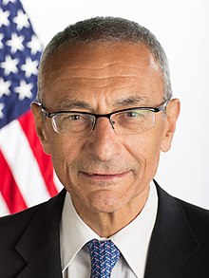
The Big Phish
March 19, 2016
Target: John Podesta
Chief of Staff for Bill Clinton (‘98-’01)
Counselor to the President for Barak Obama (‘14-’15)
Chairman of Hillary Clinton’s 2016 campaign
Personal Gmail account hacked
Messages from 2007 through 2016
Gave over login information via link in following phishing email
What looks “off” about the email to you?

Slide 8
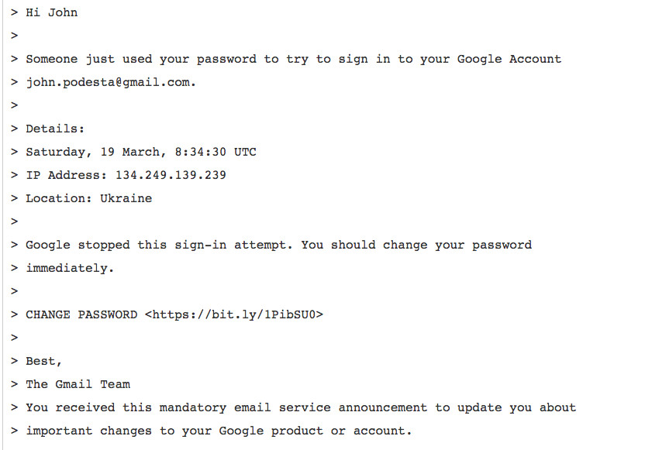

Slide 9

Filling the Net
Podesta used the Bit.ly link to “reset” his password
Shocker: it wasn’t actually from Google
Ten years of personal emails were copied
Email messages published on WikiLeaks
Exposed email exchanges caused huge uproar in 2016 presidential election cycle
Culprits: Fancy Bear
Russian intelligence-backed hacker group [may be a silly name, they’re a serious group]
Also responsible for hacking DNC in 2016 presidential election

